Slide 1
TEMPO Health Applications
Susan Alexander, Mike Newchurch, Todd McKinney
University of Alabama in Huntsville

Slide 2

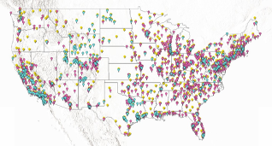
Integrating TEMPO data with surface-level air-quality measurements for health
applications.
(Investigators: Dr. Susan Alexander*, Dr. Mike Newchurch*, T. McKinney*)
Purpose: integrate surface level air- quality and TEMPO measurements to generate sub-hourly data at hyperlocal scales for determination of health impacts and support for applications-level use cases
Societal benefits: Improved characterization of exposure and response patterns at traditionally low-pollution sites in the southeast U.S., focusing on fire /smoke plumes associated with prescribed burns and wildfires. Linking these datasets will be useful for additional research designed to expand knowledge of regional health risks for acute and chronic air pollution exposures.
TEMPO products:L3 products: gridded l2
products for ozone profiles,
total ozone, NO2, and aerosols at optimal
latency <24 hours, typically hourly
Region of interest: Alabama (latitude 32.3,
longitude 86.9) , Mississippi (latitude 33.0,
longitude -90.0), and Georgia (latitude 33.2,
longitude -83.4).
Time period of interest: 12 month period, with daily
repeat time during steep gradient events.
*University of Alabama in Huntsville
I
Figure 1. Existing EPA surface-level monitoring sites for air pollutants.

